Slide 1

Video Game Library Application
"Organize, Track, and Enjoy Your Gaming Collection Effortlessly - Created by [Karim Kanaan/NBCC]"

Slide 2
Video Game Library Application
Game & Platform Management: Navigate, add, delete, and update game and platform data effortlessly.
Interactive Data Grids: Browse platforms and games and view detailed associations and insights.
Comprehensive Library: Access a full library of games while being able to navigate, add, delete, and update data.
Purchase Cart: Store and buy games directly from the application.
An all-in-one solution for gamers to manage, explore, and expand their collections seamlessly.

Slide 3
Business Rules for the Video Game Library Application
To enhance your shopping experience, we have implemented the following discount policies:
Bulk Purchase Discount: Users who purchase more than two games in a single transaction will receive a 25% discount on their total purchase.
Loyalty Discount: Users will be granted a 10% discount on their next purchase after every five games purchased.

Slide 4
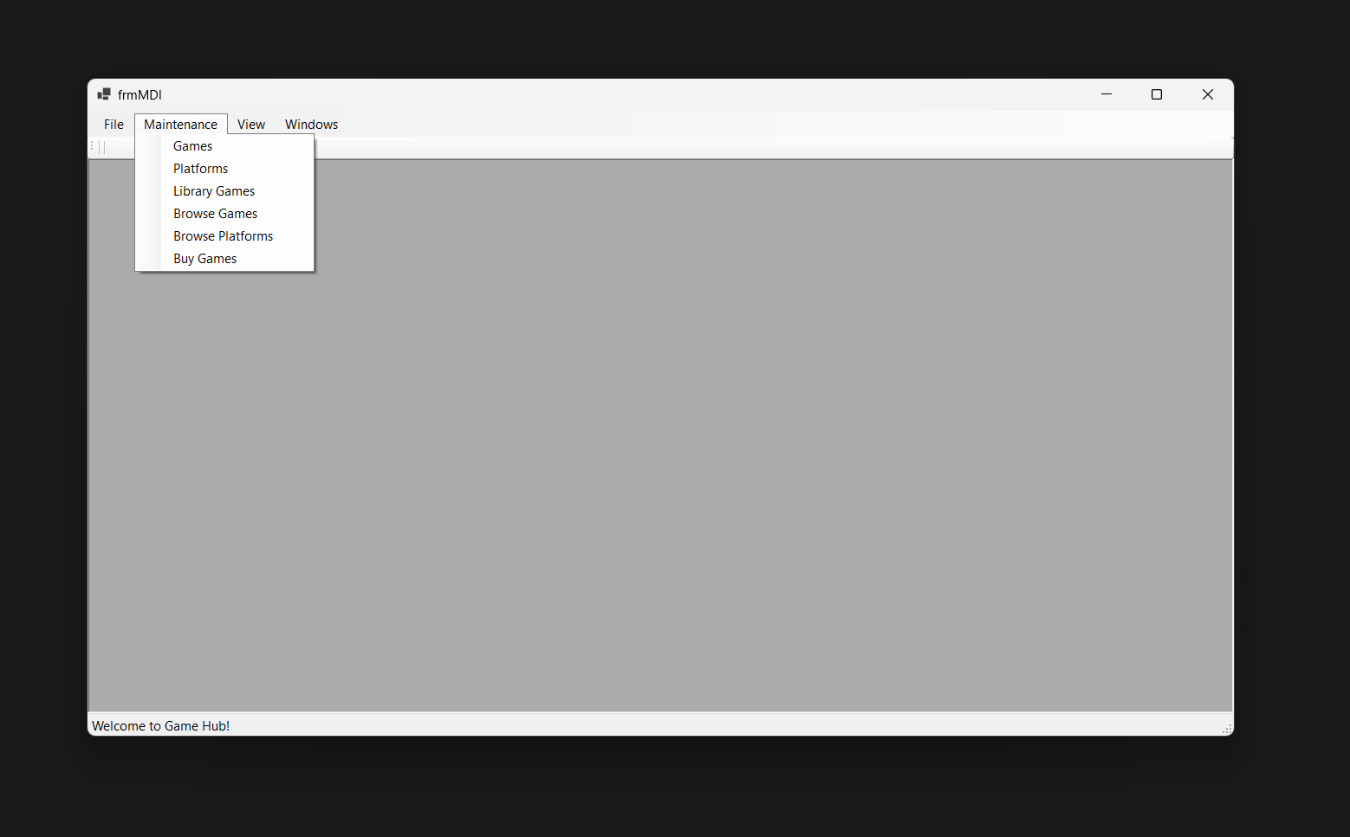
After completing the splash and login screens, users will be presented with an MDI (Multiple Document Interface) form. Clicking on “Maintenance” will allow them to access any desired form.

Slide 5
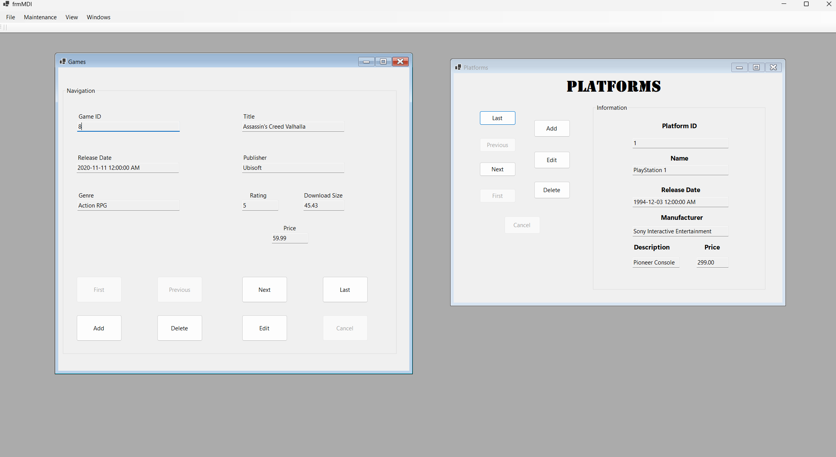
This is how the main navigation system will function: it features buttons for easy navigation and a user interface that displays data.

Slide 6
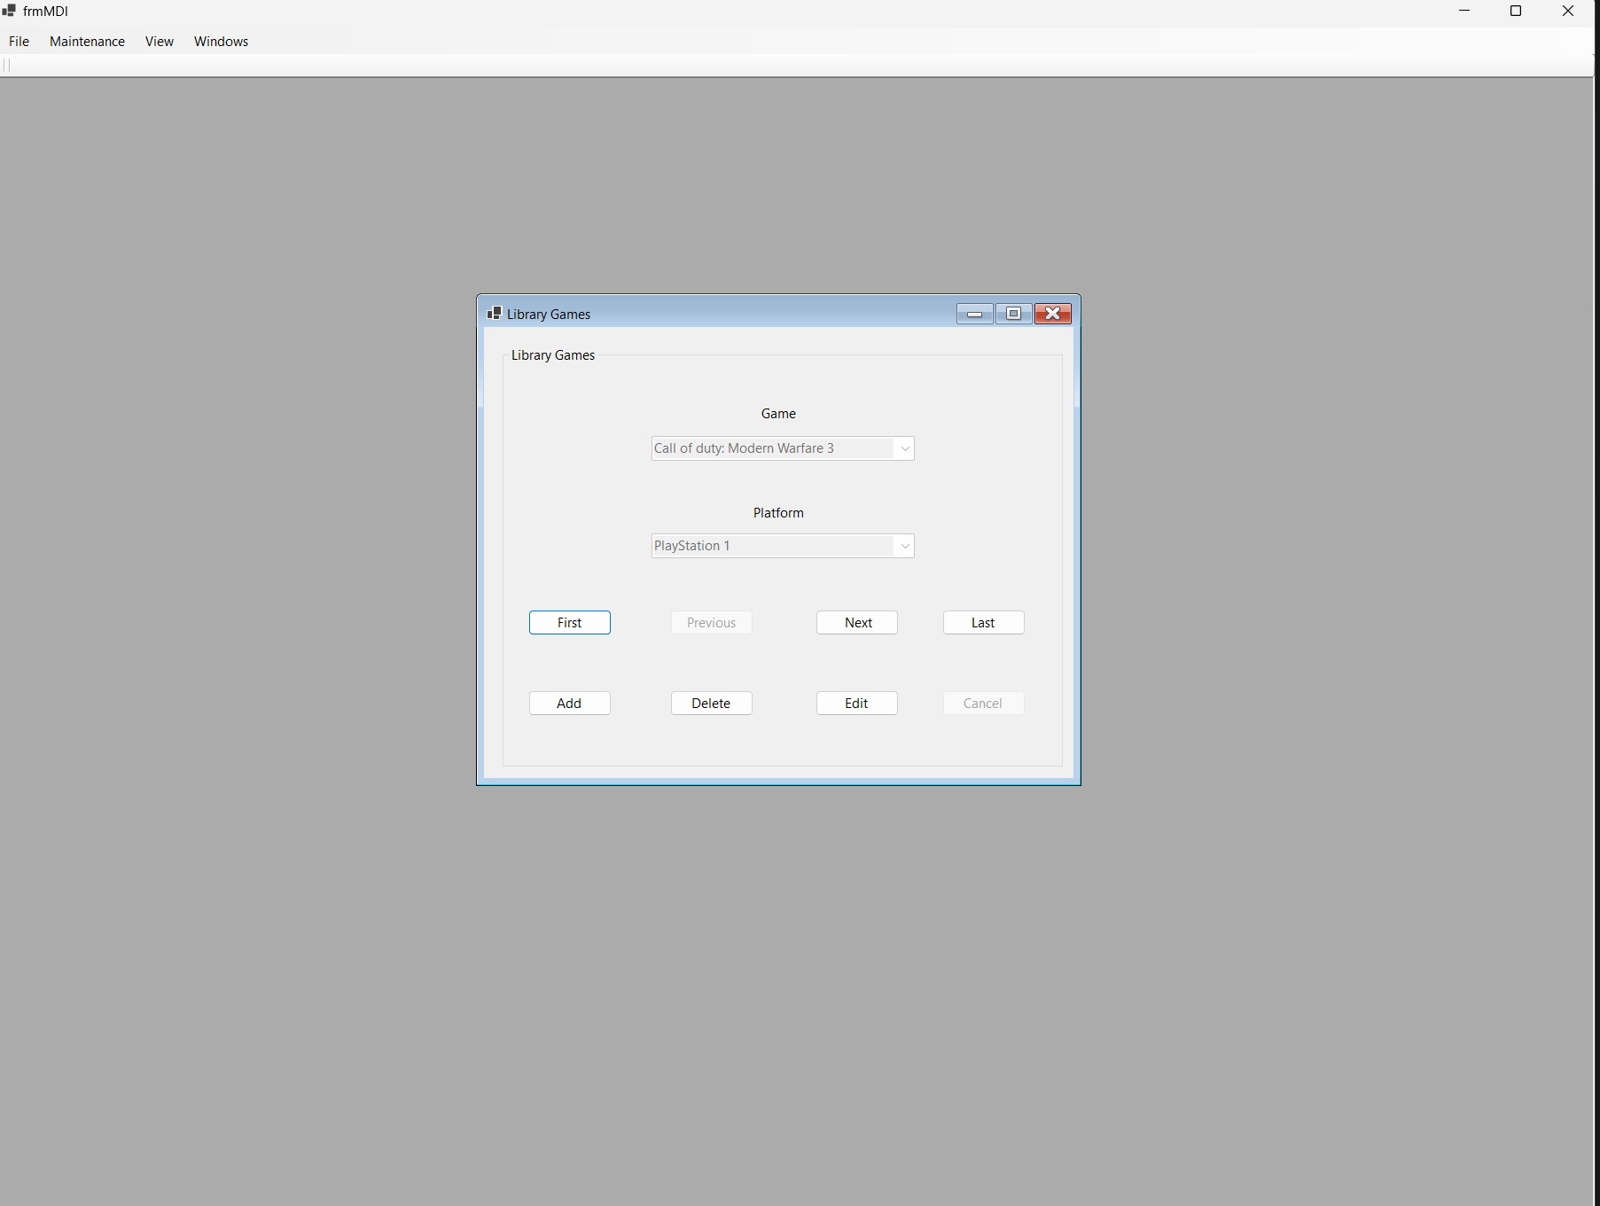
The navigation system displays all the user's purchased games.

Slide 7
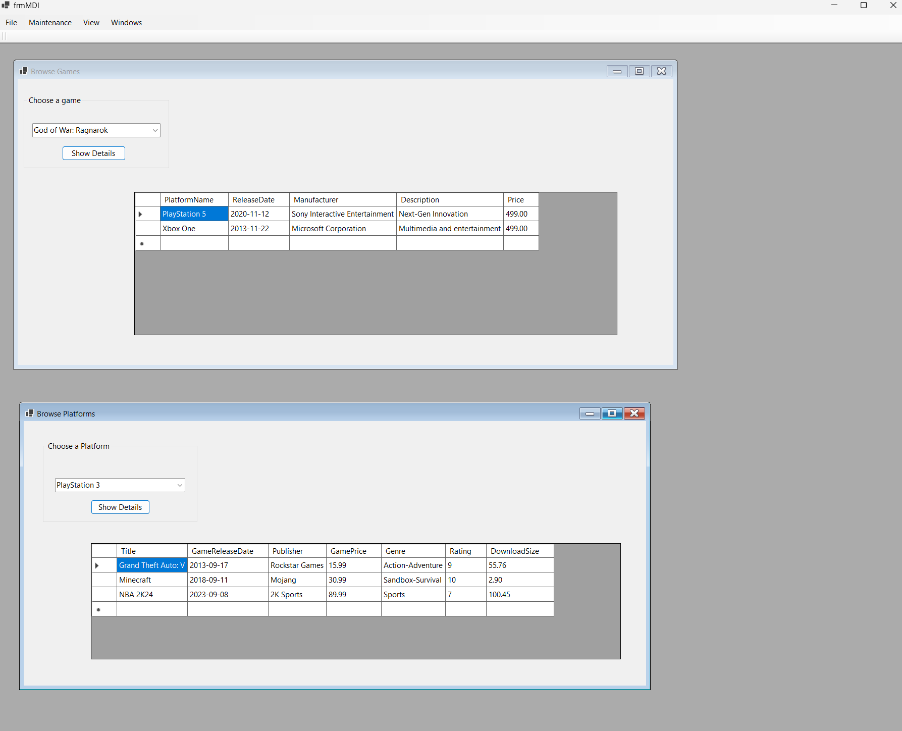
Demonstrating Browse Form Operations

Slide 8
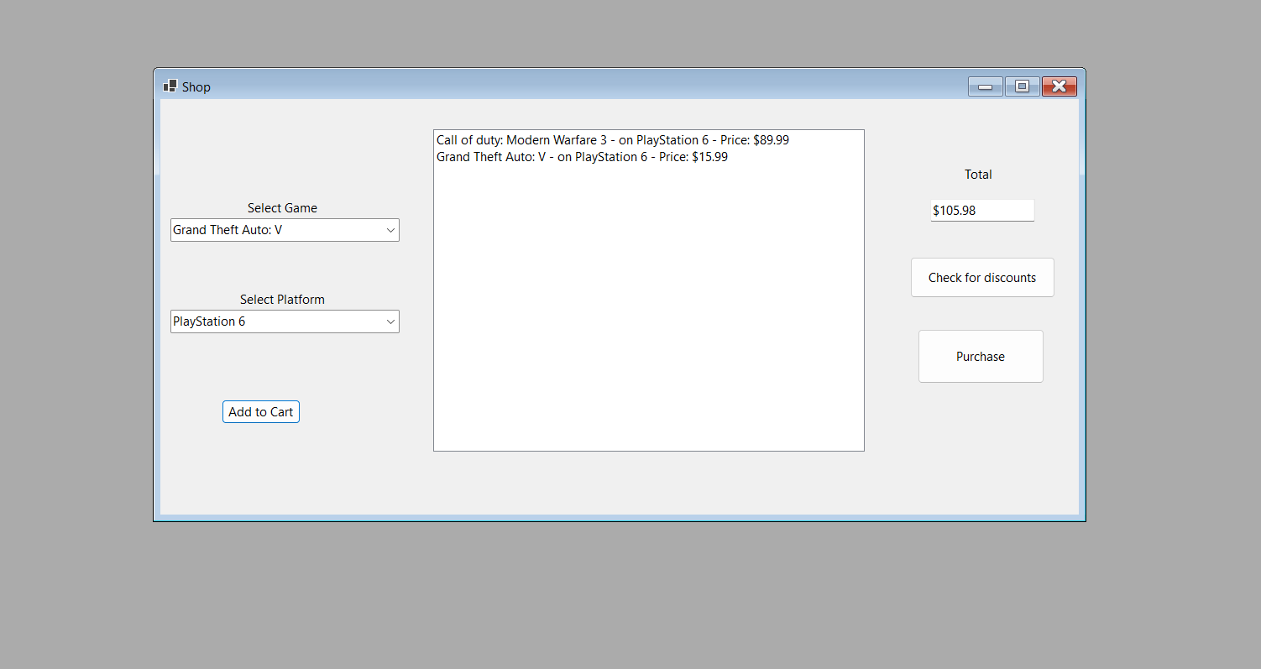
This is where users can store games in a cart and complete their purchase. After the purchase, the library games form will update to show the new additions along with the rest of the purchased games.

Slide 9

Thank you
The presentation of the running application will commence very shortly.

